Slide 1


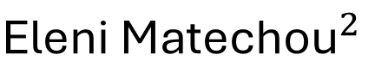

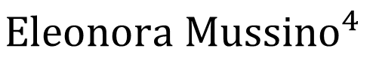
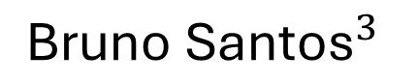
Estimating Population Size from Register Data: a Capture-Recapture Approach
${\text{Lucy} \text{Brown}}^{1}$: lyb3@kent.ac.uk
$${\text{Eleni} \text{Matechou}}^{2}$$
$${\text{Bruno} \text{Santos}}^{3}$$
$${\text{Eleonora} \text{Mussino}}^{4}$$
1 University of Kent, UK
2 Queen Mary University of London, UK
3 Universidade de Lisboa, Portugal
4 Stockholm University, Sweden

Slide 2
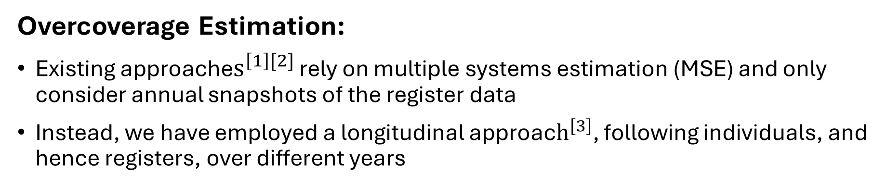
Motivating Case Study
[1] Andrea Monti, Sven Drefahl, Eleonora Mussino, and Juho Härkönen. Over-coverage in population registers leads to bias in demographic estimates. Population Studies, 74(3):451–469, 2020
[2] Eleonora Mussino, Bruno Santos, Andrea Monti, Eleni Matechou, and Sven Drefahl. Multiple systems estimation for studying over-coverage and its heterogeneity in population registers. Quality & Quantity, 1–24, 2023
[3] Bruno Santos, Eleonora Mussino, Sven Drefahl, and Eleni Matechou. Using population register data and capture-recapture models to estimate over-coverage in Sweden. Scientific Reports, 14(1):1-10, 2024
Overcoverage:
Due to imperfect emigration and/or death registration
Leads to serious bias in population estimates
Negatively influences policy-making and research
Overcoverage Estimation:
Existing approache$s^{\left[1\right][2]}$ rely on multiple systems estimation (MSE) and only consider annual snapshots of the register data
Instead, we have employed a longitudinal approac$h^{\left[3\right]}$, following individuals, and hence registers, over different years

Slide 3

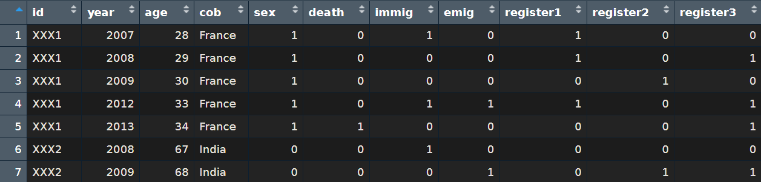

Administrative Register Data
An arbitrary number of registers
Provided by a national statistics agency (e.g. Statistics Sweden – SCB, or Statistics Norway - SSB)
Emigration, Immigration and Death records
All foreign-born residents who first entered the country as adults during the study years
(e.g. for Sweden 2003-2016,
or for Norway 2007-2023)
Covariates (treated as categorical)
Age
Country of birth
Sex
Time since first entry

Slide 4
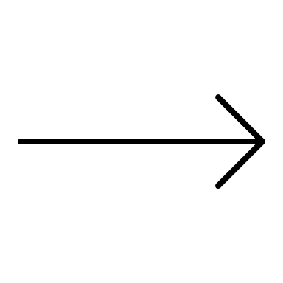
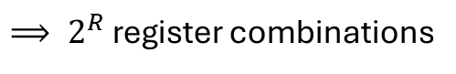
Observations
An individual is observed on some combination of R registers, on which they can be observed (1) or not observed (0), i.e. 2 possible outcomes for each register
$⟹ 2^{R}$ register combinations
Example Person #1
(0,1)
(1,1)
(0,0)
(0,0)
(0,0)
Death recorded
Dead
alive
alive
dead
dead
dead
Example Person #2
(1,1)
(0,1)
(0,0)
(0,0)
(1,0)
Have they been missed or are they not there anymore?
alive
alive
?
?
alive

Slide 5
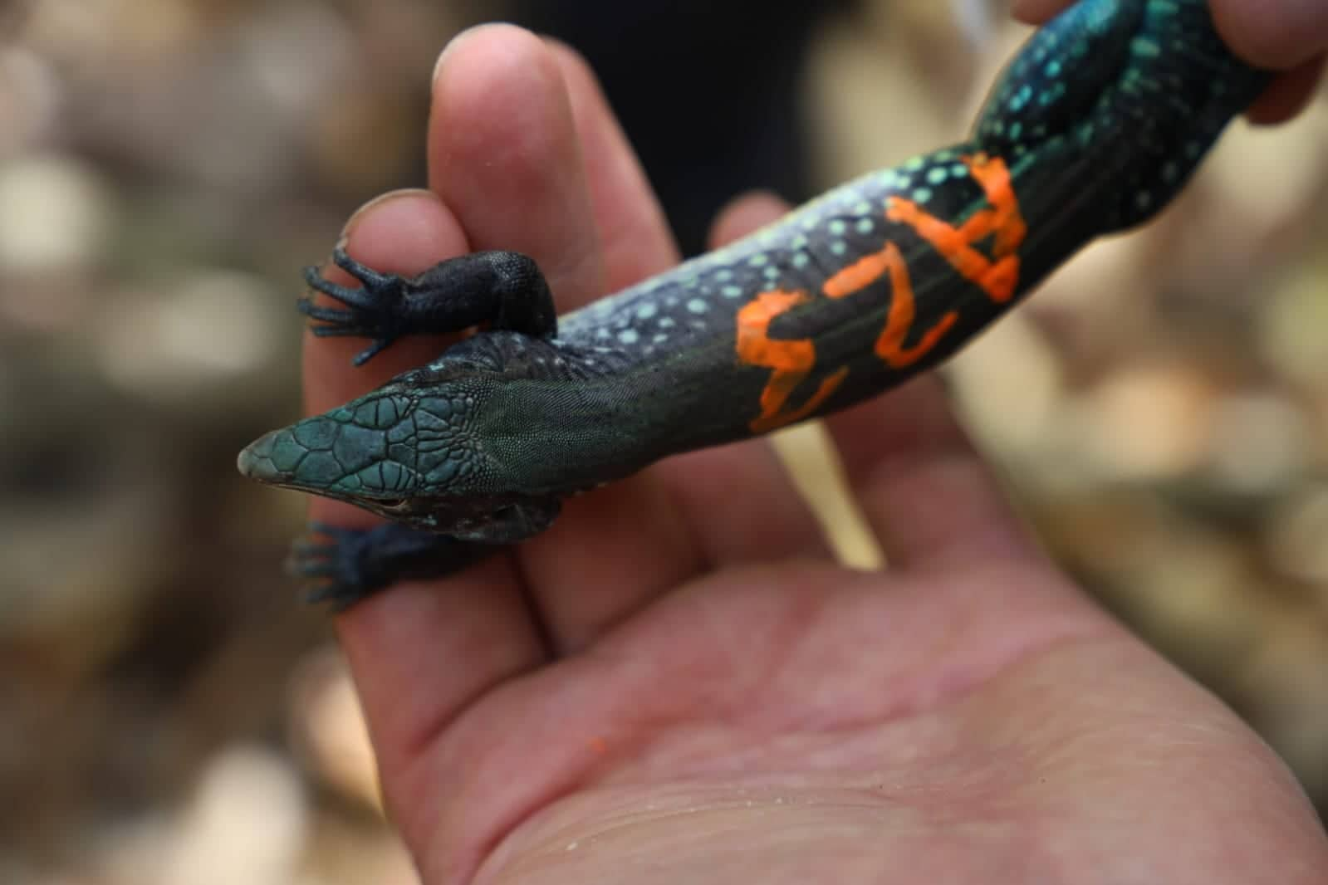

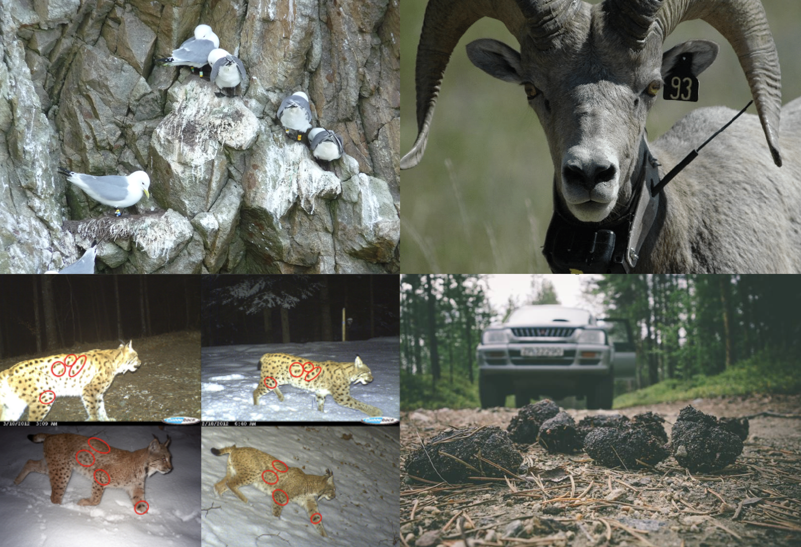
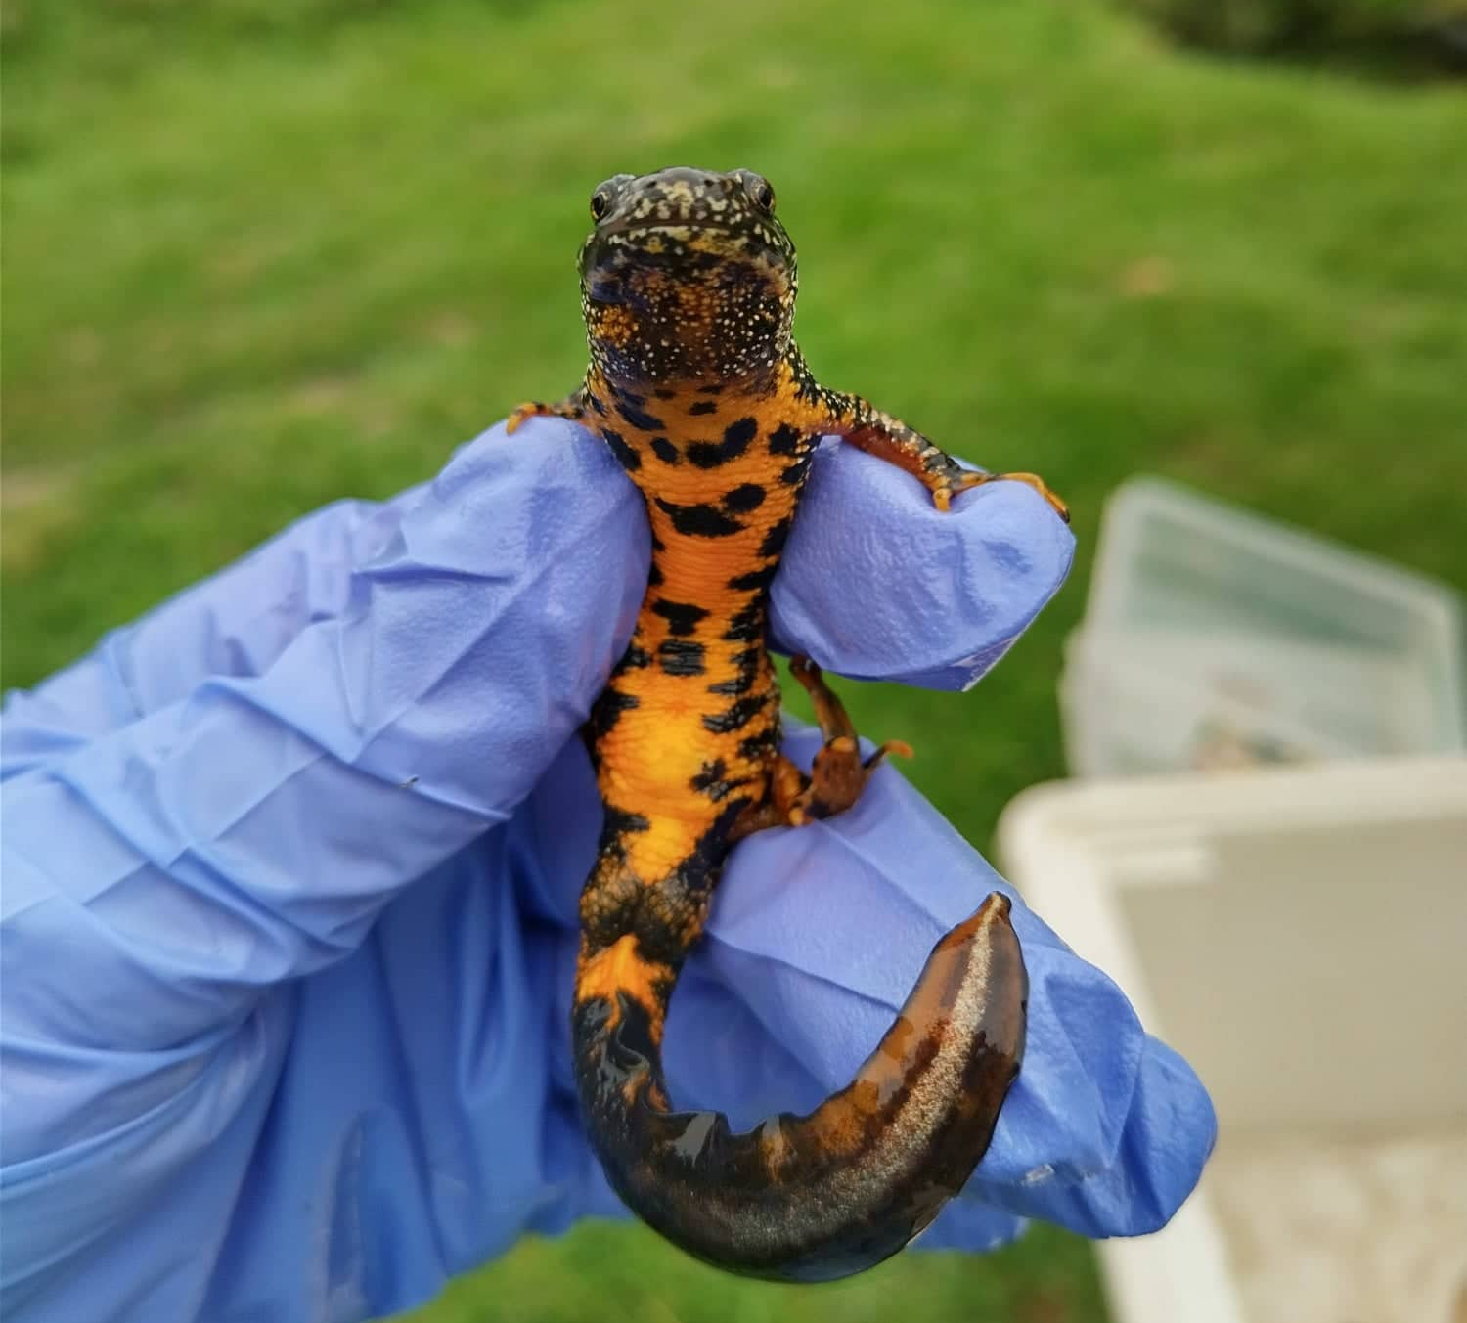
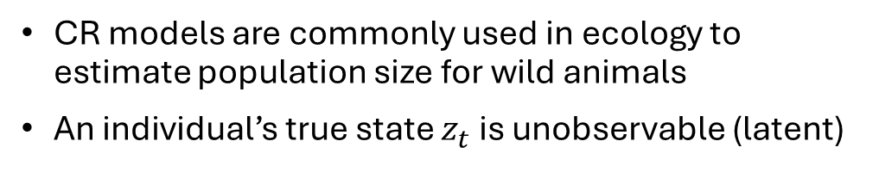
Capture-Recapture Models
Capture Recapture (CR) Models:
An initial capture is made
Unmarked individuals are marked in some unique way (tags, rings etc)
Individuals are released back into the population
Subsequent captures are made, allowing individuals to be tracked over time
Not Observed
Observed
CR models are commonly used in ecology to estimate population size for wild animals
An individual’s true state $z_{t}$ is unobservable (latent)
Left the study area
Alive but missed
Dead
Alive
Kenneth H. Pollock. Capture-recapture models. Journal of the American Statistical Association, 95(449):293–296, 2000. ISSN 01621459, 1537274X. URLhttp://www.jstor.org/stable/2669550

Slide 6
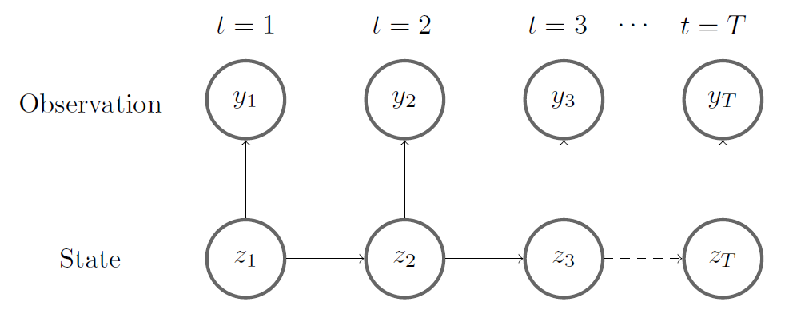
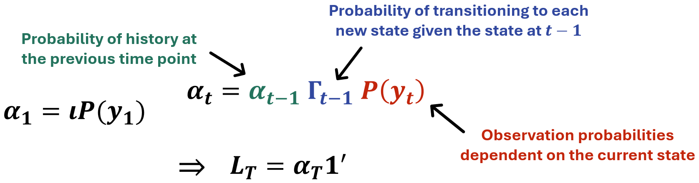
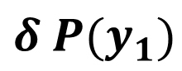
HMM Formulation
J. L. Laake. Capture-recapture analysis with hidden markov models. 2013.
Hidden Markov model (HMM) formulation marginalises over the latent state to calculate the marginal likelihood
The marginal likelihood is the probability of the observed data and the latent states, given the model parameters
Computationally expensive so use the Forward Algorithm
This iterative method is very efficient and allows latent states to be inferred
$$δ P(y_{1})$$

Slide 7
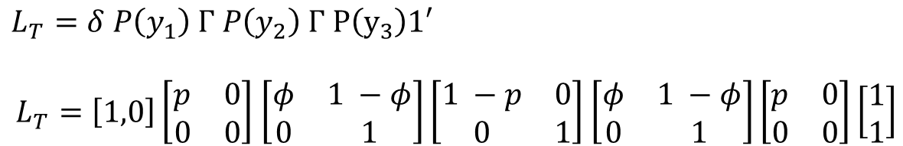
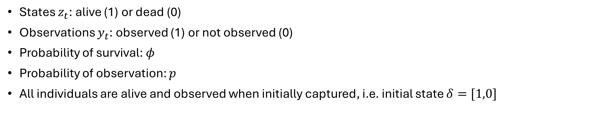
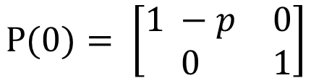
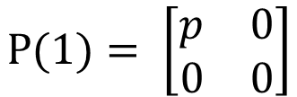
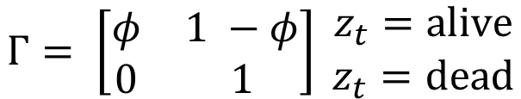
Simple CR Model
$$Γ= \left[\begin{matrix}φ & 1 −φ \\ 0 & 1\end{matrix}\right] \begin{matrix}z_{t}=alive \\ z_{t}=dead\end{matrix}$$
States $z_{t}$: alive (1) or dead (0)
Observations $y_{t}$: observed (1) or not observed (0)
Probability of survival: $φ$
Probability of observation: $p$
All individuals are alive and observed when initially captured, i.e. initial state $δ=[1,0]$
$$P(0)= \left[\begin{matrix}1 −p & 0 \\ 0 & 1\end{matrix}\right]$$
$$P(1)= \left[\begin{matrix}p & 0 \\ 0 & 0\end{matrix}\right]$$
If an individual has capture history $y_{t}=[1,0,1]$, they have a likelihood:
$L_{T}=δ P\left(y_{1}\right) Γ P\left(y_{2}\right) Γ P\left(y_{3}\right)1′$
$L_{T}=\left[1,0\right]\left[\begin{matrix}p & 0 \\ 0 & 0\end{matrix}\right]$ $\left[\begin{matrix}φ & 1 −φ \\ 0 & 1\end{matrix}\right]\left[\begin{matrix}1 −p & 0 \\ 0 & 1\end{matrix}\right]$ $\left[\begin{matrix}φ & 1 −φ \\ 0 & 1\end{matrix}\right]\left[\begin{matrix}p & 0 \\ 0 & 0\end{matrix}\right]\left[\begin{matrix}1 \\ 1\end{matrix}\right]$

Slide 8










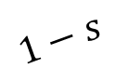
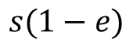
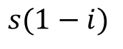
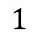
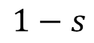
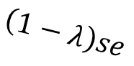
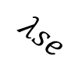
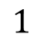
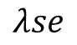
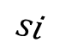
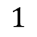
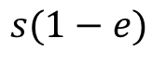
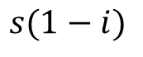
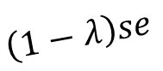
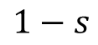
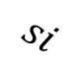
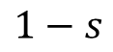
States
$$s(1−e)$$
1. in the country and alive
$$1−s$$
$$s(1−i)$$
$$si$$
2. in the country and just dead
$$s(1−e)$$
$$λse$$
$$\left(1−λ\right)se$$
4. outside the country and did not de-register
$$1−s$$
$$\left(1−λ\right)se$$
6. just returned and having de-registered
$$s(1−i)$$
$$1$$
$$si$$
3. outside the country and de-registered
$$λse$$
$$1−s$$
e = emigration
i = (re-)immigration
λ = de-registering
s = survival
7. long dead
$$1−s$$
5. outside the country and just dead
$$1$$
$$1$$

Slide 9
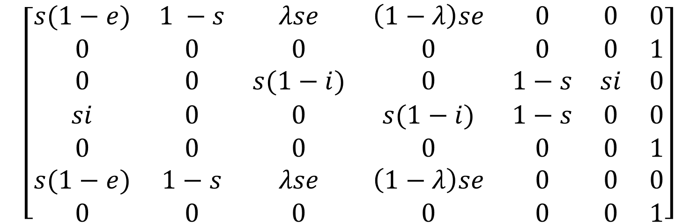
Transition Matrix
$$\left[\begin{matrix}s(1−e) & 1 −s & λse & \left(1−λ\right)se & 0 & 0 & 0 \\ 0 & 0 & 0 & 0 & 0 & 0 & 1 \\ 0 & 0 & s(1−i) & 0 & 1−s & si & 0 \\ si & 0 & 0 & s(1−i) & 1−s & 0 & 0 \\ 0 & 0 & 0 & 0 & 0 & 0 & 1 \\ s(1−e) & 1−s & λse & \left(1−λ\right)se & 0 & 0 & 0 \\ 0 & 0 & 0 & 0 & 0 & 0 & 1\end{matrix}\right]$$
In the country and alive
In the country and just dead
Outside the country and de-registered
Outside the country but didn’t de-register
5. Outside the country and just dead
6. Just returned to the country having de-registered
7. Long dead

Slide 10



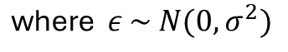
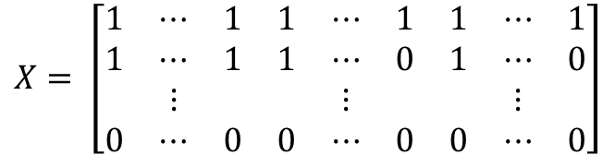
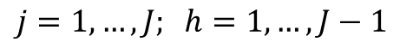
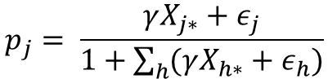

Model Coefficients Specification
Parameters in the transition matrix are specified using logistic regression:
$logit\left(θ\right)=β_{0}+β_{1}C_{1}+β_{2}C_{2}+ …+ε$ where $ε \sim N(0, σ^{2})$
Individual- and time-dependent covariates C
Random effects
Parameters in the observation matrix are specified using multinomial regressio$n^{[4]}$:
$$X= \left[\begin{matrix}1 & ⋯ & 1 & 1 & ⋯ & 1 & 1 & ⋯ & 1 \\ 1 & ⋯ & 1 & 1 & ⋯ & 0 & 1 & ⋯ & 0 \\ & ⋮ & & & ⋮ & & & ⋮ & \\ 0 & ⋯ & 0 & 0 & ⋯ & 0 & 0 & ⋯ & 0\end{matrix}\right]$$
$$p_{j}= \frac{γX_{j∗}+ε_{j}}{1+\sum_{h}{(γX_{h∗}}+ε_{h})}$$
$$\text{where} ε \sim N(0, σ^{2})$$
$$j=1, …, J; h=1, …, J−1$$
Registers
Covariates
Interactions
where $p_{j}$ are the observation probabilities of each register combination
[4] A. Agresti. An introduction to categorical data analysis. John Wiley & Sons, 2nd edition, 2007.

Slide 11
Model Assumptions
All individuals are initially alive and observed registering
If an individual is observed, they must be in the country
If an individual dies in the country, their death is recorded with probability 1
If an individual de-registers when emigrating, then they must be observed re-registering the year they return
Individuals have a maximum of one migration event each year
Individuals must be present and observable for at least one year after initially entering

Slide 12
Application to Norway
(preliminary results are for 5% of the population)

Slide 13
Norwegian Register Data
Registers:
Change in marital status
Birth of a child
Obtaining Norwegian citizenship
Internal moves recorded
Main status in the labour market
Individual income
All foreign-born residents who first entered Norway between the years 2007 and 2021 as adults
548,092 individuals observed between the years 2008 and 2023
Covariates:
Kjoenn = {0, 1}
Age
18 – 35 years old
36 – 60 years old
60+ years old
Country of birth
CG1
CG2
CG3
Nordic
Possible additions include:
Time since first entering the country (covariate)
Type of migration (covariate)
Adding “Secondary status in the labour market” (register)
Splitting up “Labour market status” into employment, education, pension etc (register)

Slide 14
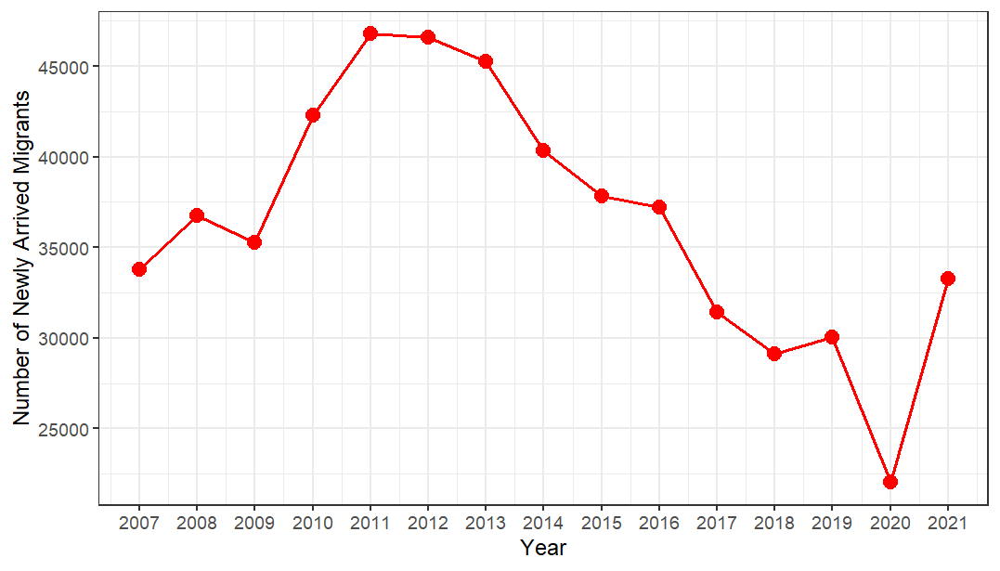
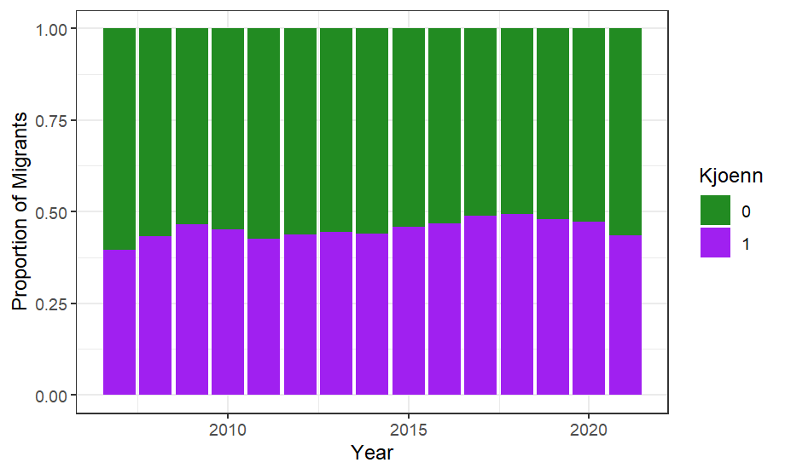
Distribution of Sex of Newly Arrived Migrants
Number of Newly Arrived Migrants Each Year

Slide 15
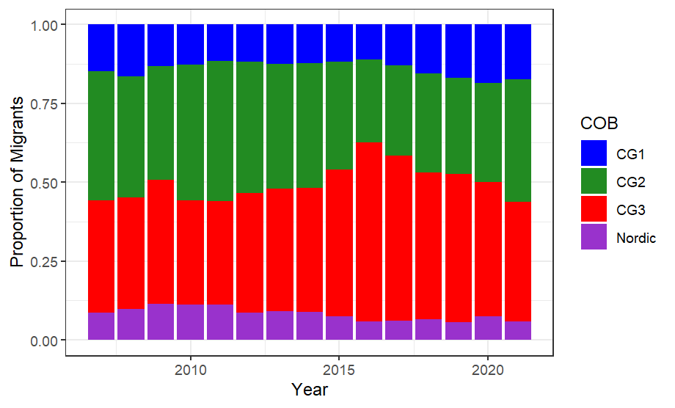
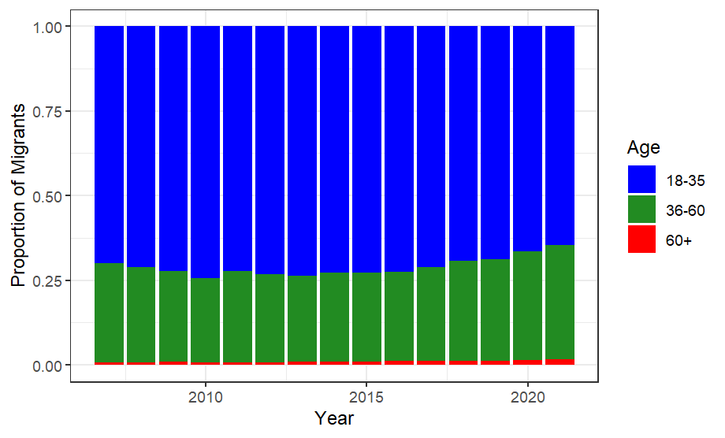
Distribution of Age of Newly Arrived Migrants
Distribution of Country of Birth of Newly Arrived Migrants

Slide 16
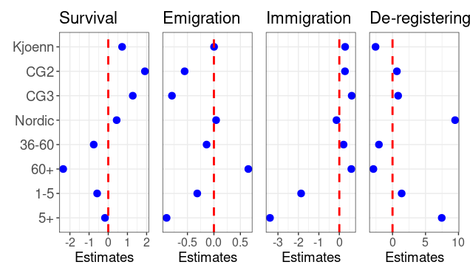
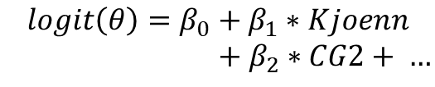
Life Event Probabilities
These estimates are on the logistic scale:
$$logit\left(θ\right)=β_{0}+β_{1}∗Kjoenn$$
$+ β_{2}∗CG2+ …$
Baseline: individuals with kjoenn 0, aged between 18 and 35 who were born in country group CG1 and first entered the country that year
Baseline values:
s = 0.9986209
e = 0.1176378
i = 0.1953825
λ= 0.8000718

Slide 17
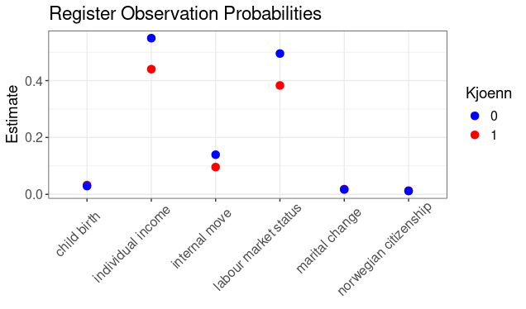
Register Observation Probabilities

Slide 18
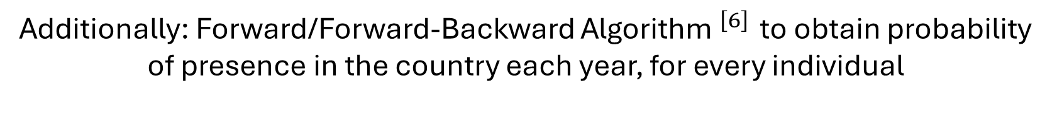
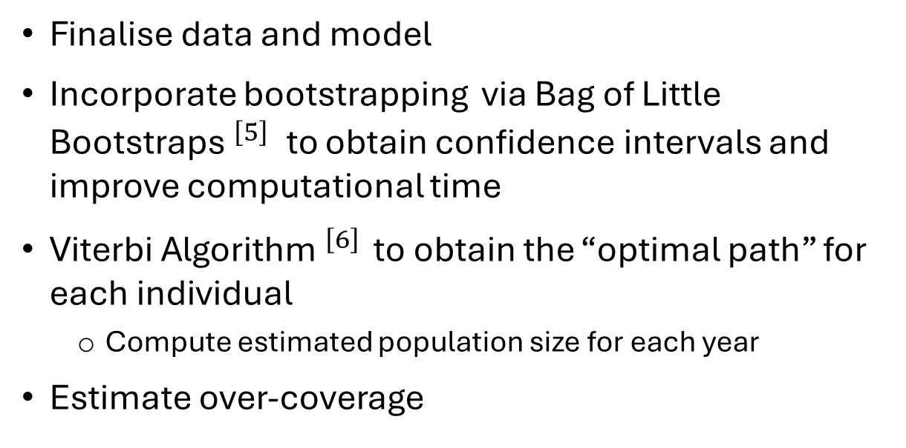
Next Steps
[5] Ariel Kleiner, Ameet Talwalkar, Purnamrita Sarkar, and Michael I Jordan. A scalable bootstrap for massive data. Journal of the Royal Statistical Society Series B: Statistical Methodology, 76(4):795–816, 2014
[6] Daniel Jurafsky and James H. Martin. Speech and Language Processing: An Introduction to Natural Language Processing, Computational Linguistics, and Speech Recognition with Language Models. 3rd edition, 2025. URL https://web.stanford.edu/ jurafsky/slp3/. Appendix A.
Finalise data and model
Incorporate bootstrapping via Bag of Little Bootstraps$^{\left[5\right]}$to obtain confidence intervals and improve computational time
Viterbi Algorithm$^{\left[6\right] }$ to obtain the “optimal path” for each individual
Compute estimated population size for each year
Estimate over-coverage
Additionally: Forward/Forward-Backward Algorithm$^{\left[6\right] }$ to obtain probability of presence in the country each year, for every individual

Slide 19
Thank you for your attention!
Email: lyb3@kent.ac.uk

